Slide 1
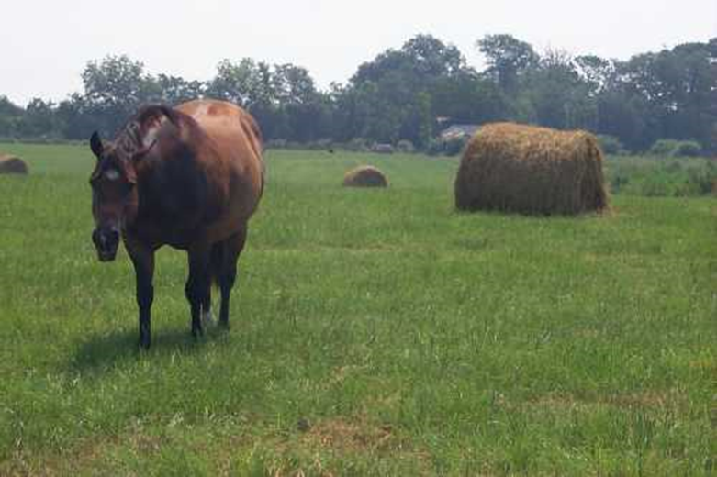
Second stage
شعار الكلية
Vitamins
By: Sara S. mohammed
Department of Veterinary Public Health
College of veterinary medicine university of Basrah
University of Basrah- College of veterinary medicine- Department of Veterinary Public Health

Slide 2
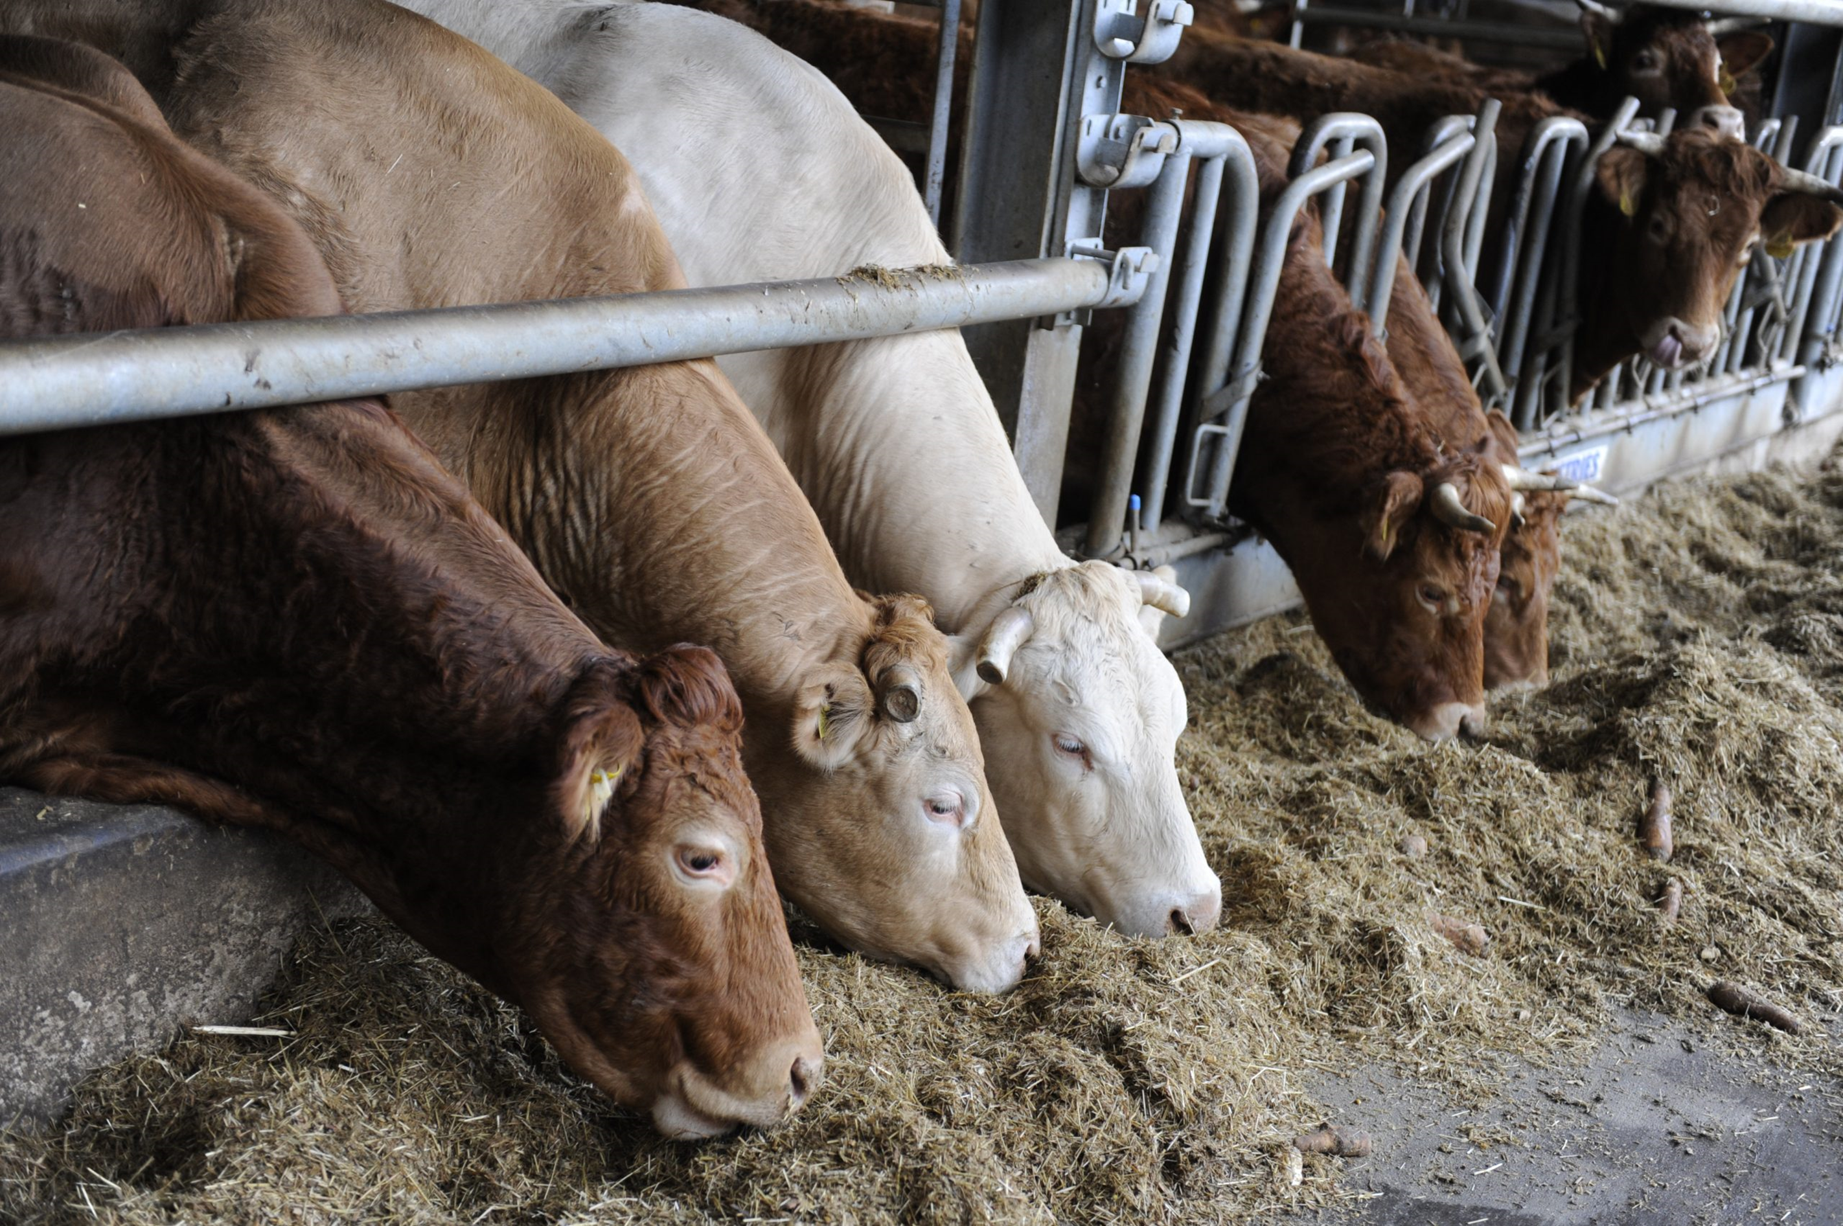
Vitamin Facts
Vitamins are essential organic nutrients, required in small amounts.
They cannot be synthesized by the body. Must be obtained by outside sources like diet, rumen bacteria & sun.
Required for growth, maintenance, reproduction and lactation.

Slide 3
Classes of Vitamins
Fat Soluble Vitamins: stored in tissues
Examples
A
D
E
K
Water Soluble Vitamins:
not stored in tissues, must have constant supply
Examples
B, B1, B2, B6 & B12
Niacin
Folic Acid
C

Slide 4
Function, Deficiency Signs & Sources

Slide 5
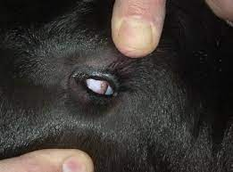
Vitamin A
Function: development healthy skin and
nerve tissue. Aids in building up resistance to infection (immune function). Functions in eyesight and bone formation. ALL ANIMALS require a source of Vitamin A. It is important in the ration of pregnant females.
Deficiency signs: retarded growth in the young, the development of a peculiar condition around the eyes known as Xerophthalmia, night blindness and reproductive disorders.
Sources: whole milk, carotene, animal body oils (cod fish and tuna), legume forages and can be synthetically produced.

Slide 6
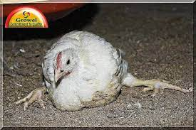
Vitamin E
Function: normal reproduction and
act as antioxidants.
Deficiency signs: poor growth, "crazy chick" disease, Muscular Dystrophy, "white muscle" disease in ruminants and swine and "stiff lamb" disease (affects the nerves and muscles).
Sources: synthetic for poultry and swine, cereal grains and wheat germ oil, green forages, protein concentrates, oil seeds (peanut and soybean oil).
Vitamin E rapidly destroyed in rancid or spoiled fats. That is why these may cause white muscle disease. Utilization of Vitamin E is dependent on adequate selenium.

Slide 7
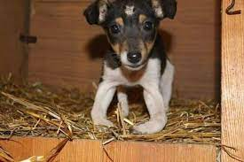
Vitamin D
Function: is essential for the proper utilization of calcium and phosphorus to produce normal, healthy bones.
Deficiency signs: retarded growth, misshapen bones (rickets), lameness and osteoporosis.
Sources: Whole milk, sun-cured hays, forage crops, fish liver oils, irradiated yeast.

Slide 8
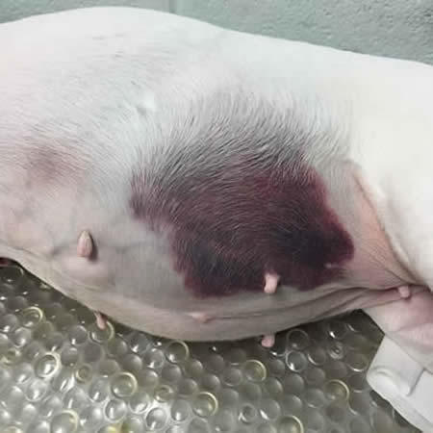
Vitamin K
Function: necessary for the maintenance
of normal blood coagulation.
Deficiency signs: blood loses its power to clot or the time needed for clotting is longer and serious hemorrhages can result from slight wounds or bruises.
Sources: green leafy forages, fish meal, liver, soybeans, rumen and intestinal synthesis, and the synthetic compounds.

Slide 9
Vitamin C (Ascorbic acid)
Function: has an effect on the metabolism of calcium in the body (Not required in rations of farm animals.).
Deficiency signs: none demonstrated in livestock. Human deficiency: scurvy (swollen and painful joints and bleeding gums) and brittleness of bones.
Sources: citrus fruits, tomatoes, leafy vegetables and potatoes.

Slide 10
Vitamin B₁ (Thiamin)
Function: required for the normal metabolism of carbohydrates.
Deficiency signs: loss of appetite, muscular weakness, severe nervous disorders, general weakness and wasting (BeriBeri).
Sources: raw, whole grains and especially their seed coats and embryos; fresh green forage; and yeast, milk and rumen synthesis.

Slide 11
Vitamin B₂ (Riboflavin)
Function: necessary for normal embryo development, important in the metabolism of amino acids and carbohydrates.
Deficiency signs: poor reproduction characterized by small litters and deformed young (cleft palate and club-footedness) curly toe paralysis in chicks, digestive disturbances, general weakness and eye abnormalities.
Sources: milk and dairy by-products, yeast, green forages, well cured hay (especially alfalfa), whole grains, wheat bran and synthetic riboflavin rumen synthesis.

Slide 12
Vocabulary Review
Nutrients: chemical substances in food that are used by the body to produce energy and tissues.
Vitamins: essential organic nutrients, required in small amounts, that cannot be synthesized by the body. Required for growth, maintenance, reproduction and lactation.
Vitamin deficiency: decline in health due to the lack of a vitamin in a ration.

Slide 13
Vocabulary Review
Fat soluble vitamin: a vitamin that can be stored and accumulated in the liver and other fatty tissues.
Water soluble vitamin: a vitamin that cannot be stored in the tissues. Must be provided regularly as deficiencies can develop in a short time.

